Slide 1


Big Data Technologies REVIEW – 1 Real-Time E-Commerce User Analytics and Recommendation System
Team No- 14
Roll No Name
u.chandrahas 2320030041
S.pardhu 23200300226
d.Nagarjuna 2320030482
Department of Computer Science and Engineering
KONERU LAKSHMAIAH EDUCATION FOUNDATION

Slide 2
OUTLINE
• Abstract
• Introduction
• Objectives
• Literature Survey
• Implementation
• Conclusion
• References

Slide 3
Abstract
In modern educational institutions, massive volumes of student performance data such as attendance, internal marks, and behavioral metrics are generated continuously. Traditional systems are unable to efficiently analyze this high-volume data to identify at-risk students or predict academic outcomes before final evaluations. This project presents a Strategic AI-Driven Academic Intelligence & Intervention Dashboard using Big Data technologies such as Apache Spark and Machine Learning. The system ingests large-scale academic datasets, processes them through a distributed Medallion data architecture, and applies predictive modeling to generate actionable student insights. Processed metrics are visualized through interactive dashboards and used to instantly automate the production of professional PDF reports and documentation. The proposed solution demonstrates a scalable, fault-tolerant approach to educational management, supporting data-driven decision-making to improve student success rates in high-scale academic environments

Slide 4
Introduction
This project proposes a Predictive Student Analytics & Performance Dashboard using Big Data technologies like Apache Spark and Parquet columnar storage. The system processes academic data in a distributed environment and utilizes Machine Learning (Decision Tree) models to provide live performance outcomes and visual insights through a web-based dashboard, enabling faster and more data-driven administrative decisions.

Slide 5
Objectives
To design a real-time data pipeline for e-commerce user activity.
To collect and process high-volume streaming data using Apache Kafka.
To implement distributed data processing using Apache Spark.
To integrate streaming data with structured demographic data.
To use ML Algorithms for analytics.
To build an interactive dashboard for real-time visualization.

Slide 6
Proposed Method
Data Ingestion: Academic records and student engagement metrics such as attendance and assessment scores are processed using an Apache Spark ETL pipeline.
Data Integration: High-velocity performance data is aggregated into a Parquet Gold Layer and integrated with relational student profiles stored in SQLite.
Machine Learning Models:
Decision Tree Classifier $\rightarrow$ Predict student final grade and academic outcome.
Feature Importance Analysis $\rightarrow$ Identify critical drivers of success (e.g., Attendance vs. Marks).
Risk Classification $\rightarrow$ Categorize students into performance zones (High Performer vs. At-Risk).
Storage: Processed metrics and system ingestion rates are stored in InfluxDB, a time-series database optimized for auditing analytical workflows.
Visualization: Real-time analytics are displayed through an Interactive Dashboard (Chart.js) and Grafana to provide live insights into departmental trends and student success rates.

Slide 7
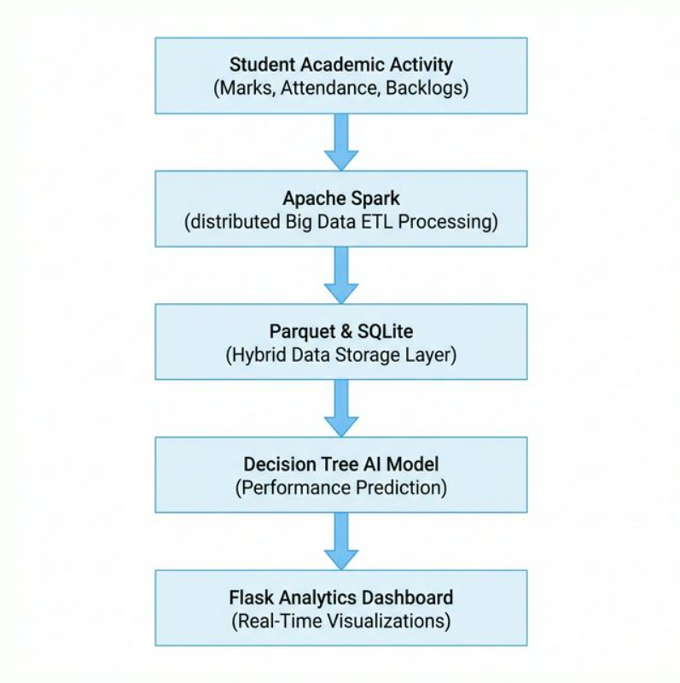
System Architecture (Block Diagram)

Slide 8
Literature Survey
Paper Link | Author Name | Journal/Conference | Drawbacks / Future Scope
LINK | KHRITISH SWARGIARY | Leveraging Artificial Intelligence for Enhanced Project Completion in Education | Some proposed models require high memory and processing power, making them expensive for practical implementation.
LINK | Ito,takao | THE ONLINE PBL (PROJECT-BASED LEARNING) EDUCATION SYSTEM USING AI (ARTIFICIAL INTELLIGENCE) | Older survey; needs updates with deep learning and big data frameworks
LINK | Jiaz khan | An artificial intelligence approach to monitor student performance and devise preventive measures | Many studies assume clean data and do not handle missing, noisy, or inconsistent real-world data.
LINK | Pencheng jiao | Artificial intelligence-enabled prediction model of student academic performance in online engineering education | Research is often tested on a single dataset, which may not represent real-world data variety.
LINK | Jose divaso’n | Artificial Intelligence Models for Assessing the Evaluation Process of Complex Student Project | Uses R for sentiment analysis; doesn’t cover big data frameworks like Spark/Hadoop.

Slide 9
Implementation
Tools Used:
Flask (Web Backend Framework)
Apache Spark (Big Data Processing Engine)
Parquet (High-Performance "Gold Layer" Data Format)
Machine Learning (Decision Tree Classifier)
Scikit-learn (AI Model Training Library)
Pandas (Data Manipulation & Analysis)
SQLite (Transactional Database)
Chart.js (Interactive Frontend Visualizations)
InfluxDB (Time-Series Database for Monitoring)
Grafana (Infrastructure Performance Dashboards)
)

Slide 10
sConclusion
In this project, we designed a Predictive Student Performance Analytics Dashboard using advanced Big Data technologies. The system collects high-volume academic records and processes them in a distributed manner using Apache Spark and Parquet storage layers. By integrating high-speed analytical data with Machine Learning predictions, the platform provides real-time insights through interactive dashboards and automated reporting, enabling institutions to perform early student interventions and make proactive, data-driven educational decisions.

Slide 11
References
Ahmed, A., et al. (2024). "Students' performance prediction employing Decision Tree." 🔗 View on ResearchGate
Raut, S. S., & Nichat, M. K. (2017). "Students Performance Prediction Using Decision Tree Technique." 🔗 View on Semantic Scholar
Salloum, S., Dautov, R., & Huang, J. (2016). "Big data analytics on Apache Spark." 🔗 View on Springer/Semantic Scholar
MECS Press (2015). "A Decision Tree Approach for Predicting Students Academic Performance." 🔗 View Full PDF (Direct)

Slide 12
THANK YOU

